Slide 1
Correlation and Regression Analysis
A Quick Tutorial
Notes:
Slide <number>
Module08 Regression_Handout.ppt 11/08/26
Often, we are interested in how two or more variables are related to each other.
For example, we often would like to determine what kind of relationship, if any, exists between input variables and the production of a highly reliable product.
Also, we often would like to find a stress that accelerates aging of a device.

Slide 2
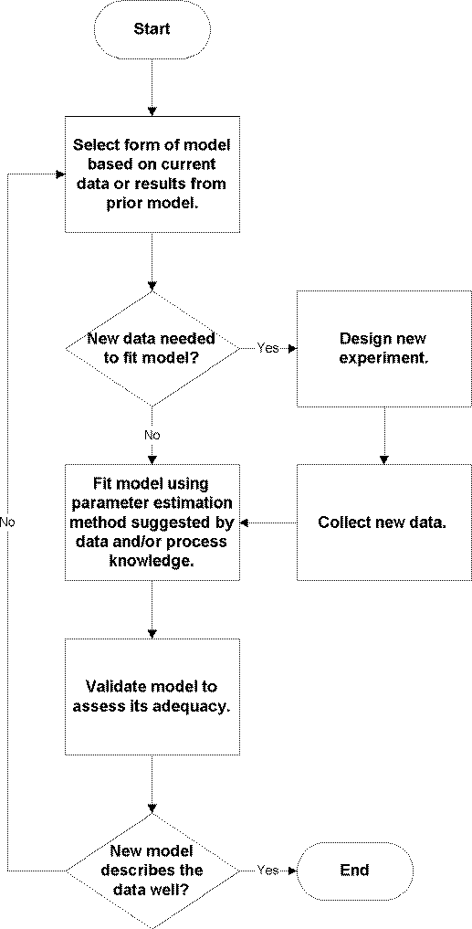
My manager asked me to develop a regression model for some data from a new process, what are the basic steps I should follow?
Notes:
Flowchart from www.itl.nist.gov/div898/handbook/toolaids/eq/eq2.htm
Modeling Methodology
Identify the real problem
Formulate a mathematical model
Obtain the mathematical solution of the model
Interpret the mathematical solution
Compare with reality: if wrong, go to step # 1
Write a report
Adapted from Guide to Mathematical Modeling, Dilwyn Edwards & Mike Hamson, p. 43-46

Slide 3
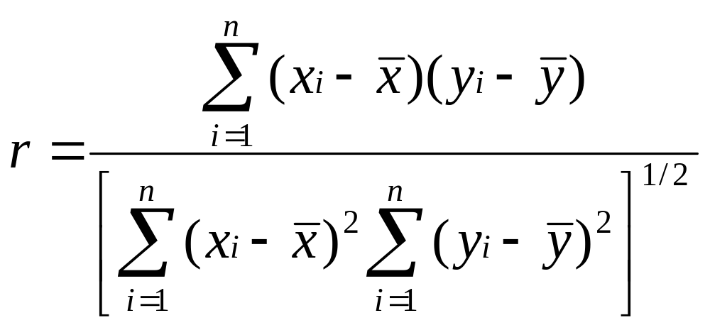
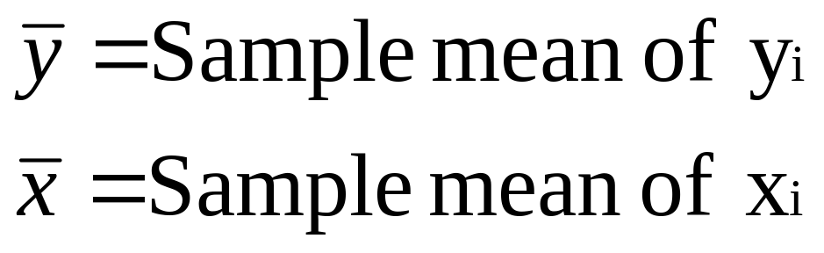
Correlation
Notes:
Slide <number>
Module08 Regression_Handout.ppt 11/08/26
The most common way to measure association is using the Pearson product moment correlation coefficient, “correlation” for short.
Values always fall between -1 and +1
A positive value indicates that as one variable increases, so does the other
A negative value indicates that the value of one variable increases as the other decreases
Values near 0 indicates that there is no linear relationship between two variables

Slide 4
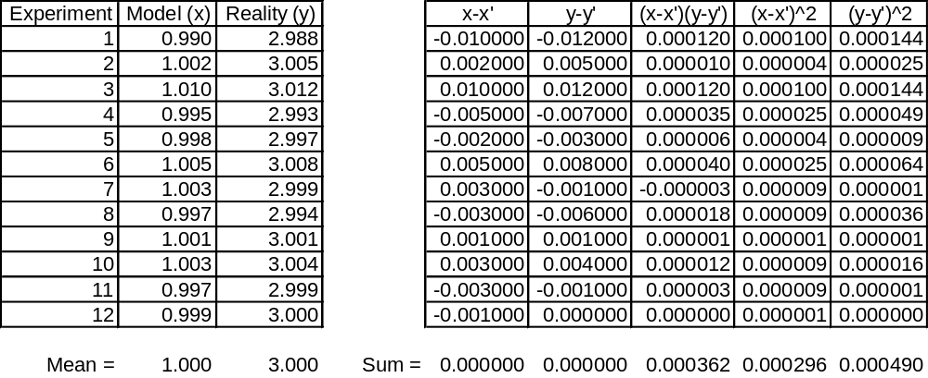
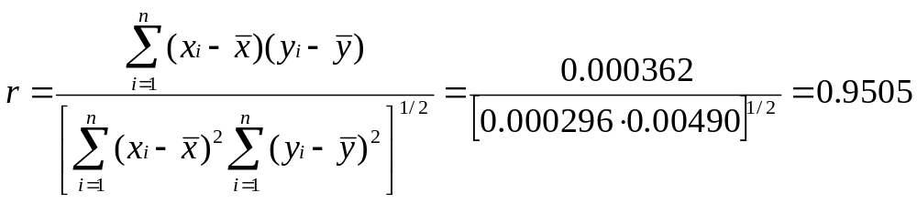
Example
Notes:
Slide <number>
Module08 Regression_Handout.ppt 11/08/26
Assume you have a model and you want to see how accurate it is.
You decide to model 12 designs and estimate the performance and then build 12 prototypes and measure the performance. Each “experiment” compares the model to reality.
The first question to ask is how correlated is the model to reality.
The correlation coefficient indicates 0.9505.

Slide 5
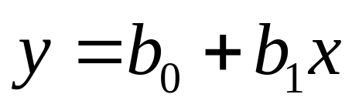
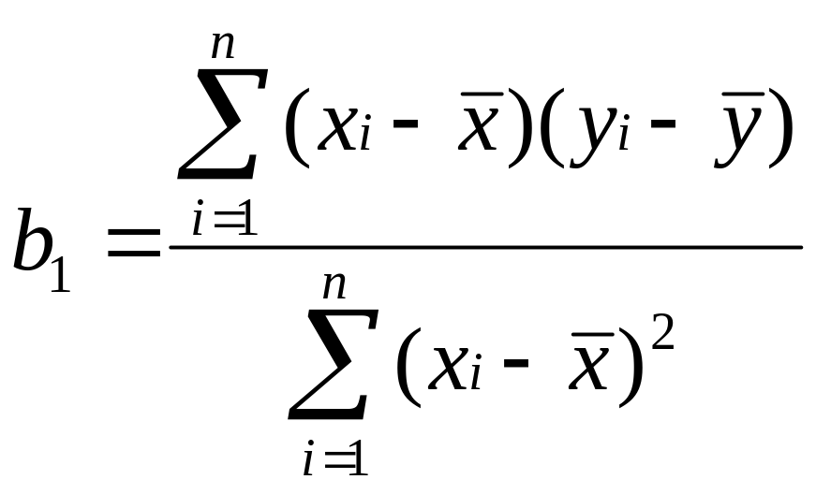
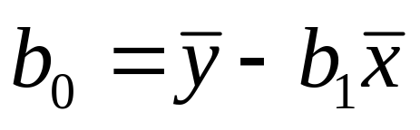
Simple Linear Regression
Equation:
Slope:
Intercept:
Notes:
Slide <number>
Module08 Regression_Handout.ppt 11/08/26
While correlation tells us how much linear association there is between two variables, simple linear regression defines this association more precisely.
Simple linear regression results in an equation that uses one variable to help explain the variation in another variable; multiple regression results in an equation that uses two or more variables to help explain the variation in another variable.
Always start with a Scatter Diagram

Slide 6
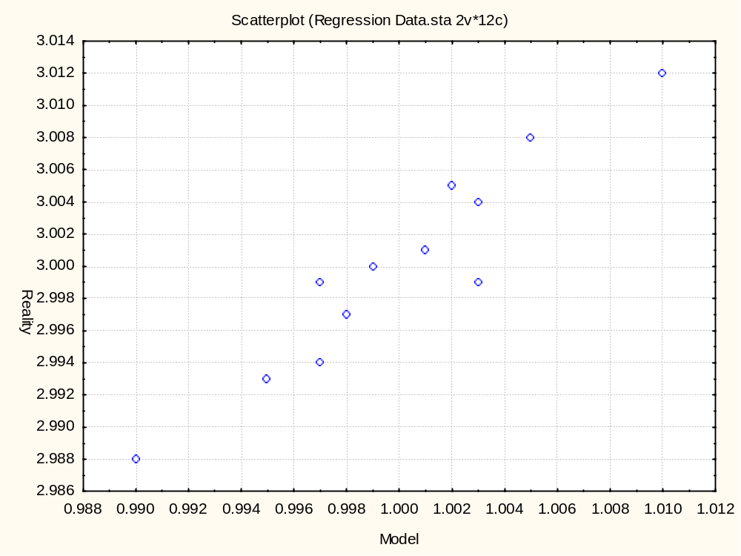
Notes:
Slide <number>
Module08 Regression_Handout.ppt 11/08/26
Scatter Diagram
What:
Plot of one variable versus another variable
Why:
To study the possible relationship between two variables
When:
Need to display what happens to one variable when another variable changes in order to test a theory that the two variables are related
How:
Collect paired samples of data that you think may be related and record them on a data sheet
Draw the horizontal and vertical axes of the diagram
Variable that is being investigated as the possible “cause” is usually on the horizontal axis
The “effect” variable is usually on the vertical axis
Plot the data on the diagram

Slide 7
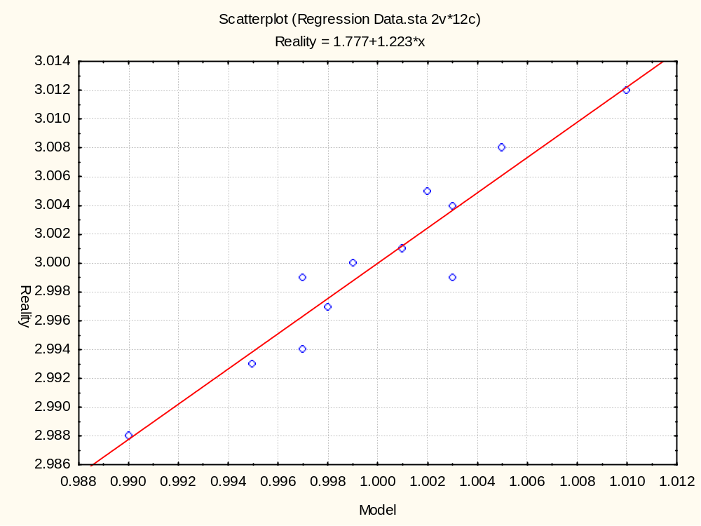
Notes:
Slide <number>
Module08 Regression_Handout.ppt 11/08/26
Simple Linear Regression
What:
Fitting a line to paired data
Why:
To quantify the possible relationship between two variables
When:
Need to test that one variable is statistically related to another
Need to predict one variable based on another
How:
Make a scatter plot of data
Estimate the best fit line
Examine model fit
Significance of terms
Correlation
Examine diagnostics
Residuals
Outliers

Slide 8
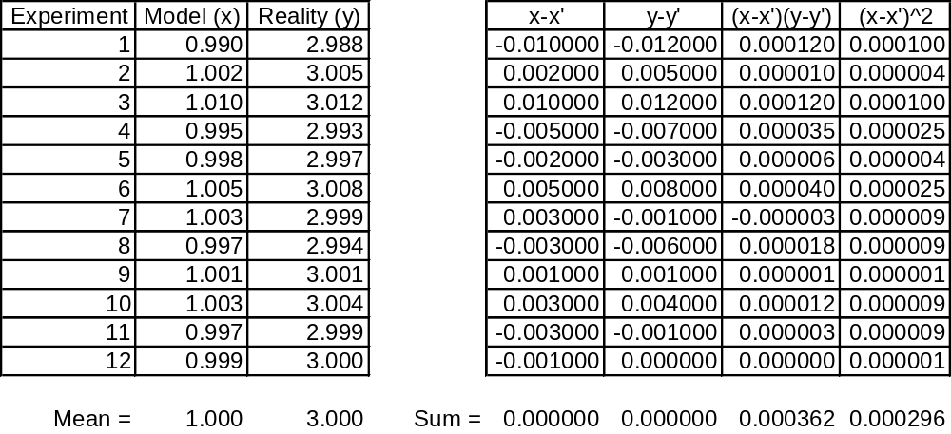
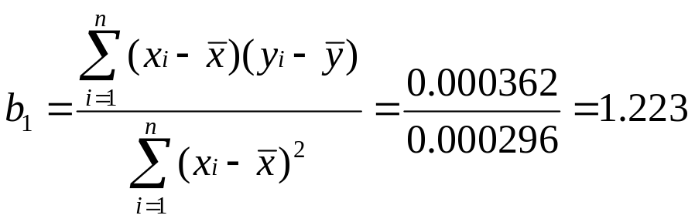
Example
Notes:
Slide <number>
Module08 Regression_Handout.ppt 11/08/26
Returning to the experiment of comparing a model to reality.
Based on the regression analysis, one would conclude that:
Reality = 1.777 + 1.223(Model)

Slide 9
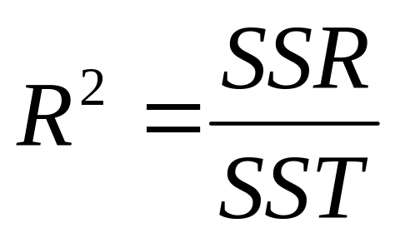
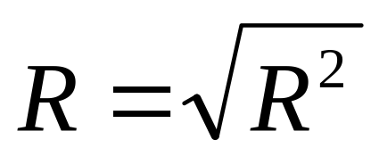
Measures of Association: r² and r
SSR = Sum of Squares Regression
SST = Sum of Squares Total
Notes:
Slide <number>
Module08 Regression_Handout.ppt 11/08/26
Coefficient of Determination (R²): proportion of variability of Y explained by X.
Correlation Coefficient (R): square root of R²
“+” if Slope (b₁) > 0
“ - ” if Slope (b₁) < 0
Warning
Do not use R² or R as the sole criteria of model fit. R² only indicates how much of the variation in Y is explained by X and, conversely, how much is not explained, which indicates if other variables should be included in the model.

Slide 10
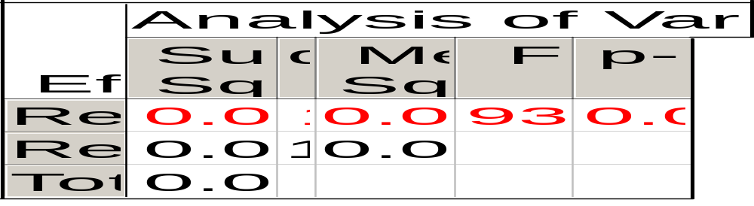
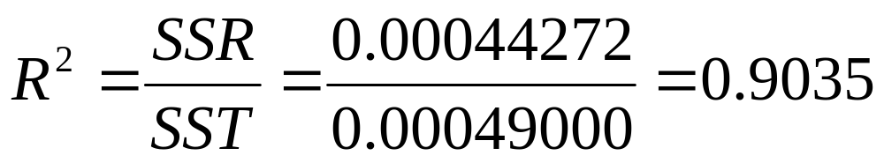
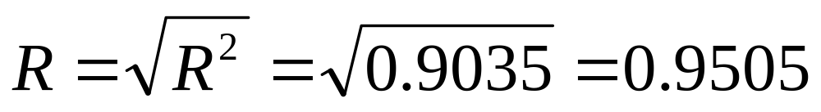
Example
Notes:
Slide <number>
Module08 Regression_Handout.ppt 11/08/26
Returning to the experiment of comparing a model to reality.
The regression analysis showed:
Reality = 1.777 + 1.223(Model)
This R² value indicates the you can explain approximately 90% of the variation in “reality” with your model.

Slide 11
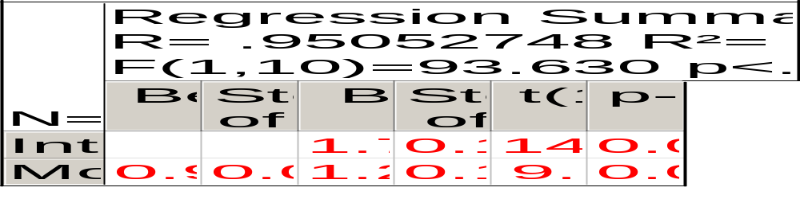
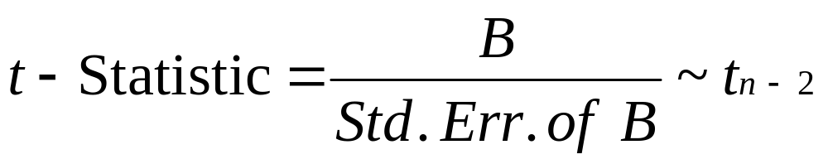
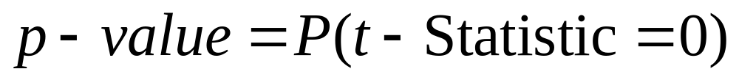
Significance of terms
Notes:
Slide <number>
Module08 Regression_Handout.ppt 11/08/26
Judge significance of a term by looking at the p-value (“p-level” on the table) based on the t-Statistic. The p-value indicates the probability that the coefficient is equal to 0.
In general, if the p-value of a term is greater than 0.05 or 0.10, then that term is judged to be statistically insignificant, i.e. not statistically different from 0. The choice of 0.05 or 0.10 is left to the user and depends on how much risk one is willing to take to declare an non-significant result as being significant.
If a term in the model has an insignificant p-value, then remove it from the model.
In this example, the p-values for the slope and intercept are very, very small, i.e. there is almost no chance that they are equal to 0.

Slide 12
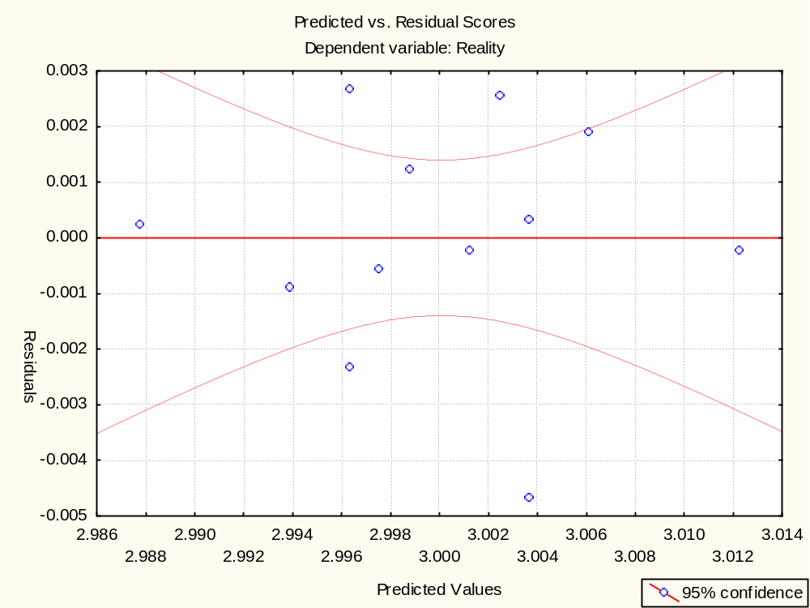
Notes:
Slide <number>
Module08 Regression_Handout.ppt 11/08/26
Key Points
Sometimes data can fool you
Understand, study, plot and analyze your data
Always examine the residuals = Actual Value – Predicted Value
This is one of many diagnostic plots of residuals.
Make sure this plot looks random.

Slide 13
Load Cell Calibration
NIST Engineering Statistics Handbook
Case Studies in Process Modeling
http://www.itl.nist.gov/div898/handbook/pmd/section6/pmd61.htm
Notes:
This example illustrates the construction of a linear regression model for load cell data that relates a known load applied to a load cell to the deflection of the cell. The model is then used to calibrate future cell readings associated with loads of unknown magnitude.
Outline
Background & Data
Selection of Initial Model
Model Fitting - Initial Model
Graphical Residual Analysis - Initial Model
Model Refinement
Model Fitting - Model #2
Graphical Residual Analysis - Model #2
Use of the Model for Prediction

Slide 14
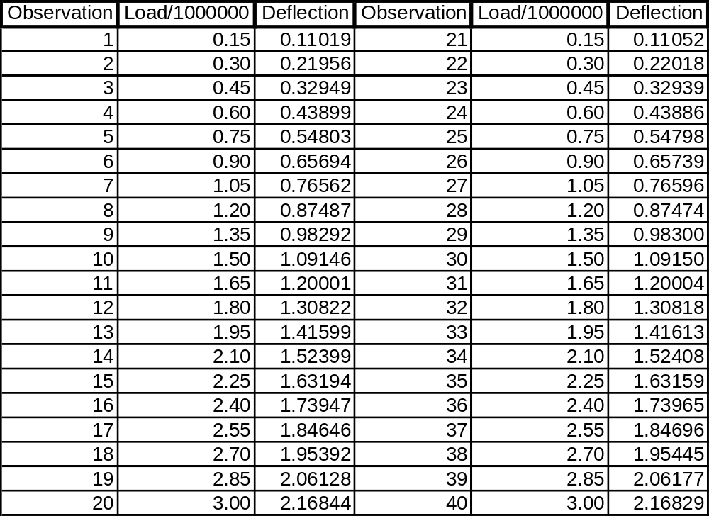
Background & Data
Notes:
The data collected in the calibration experiment consisted of a known load, applied to the load cell, and the corresponding deflection of the cell from its nominal position. Forty measurements were made over a range of loads from 150,000 to 3,000,000 units. The data were collected in two sets in order of increasing load. The systematic run order makes it difficult to determine whether or not there was any drift in the load cell or measuring equipment over time. Assuming there is no drift, however, the experiment should provide a good description of the relationship between the load applied to the cell and its response.

Slide 15
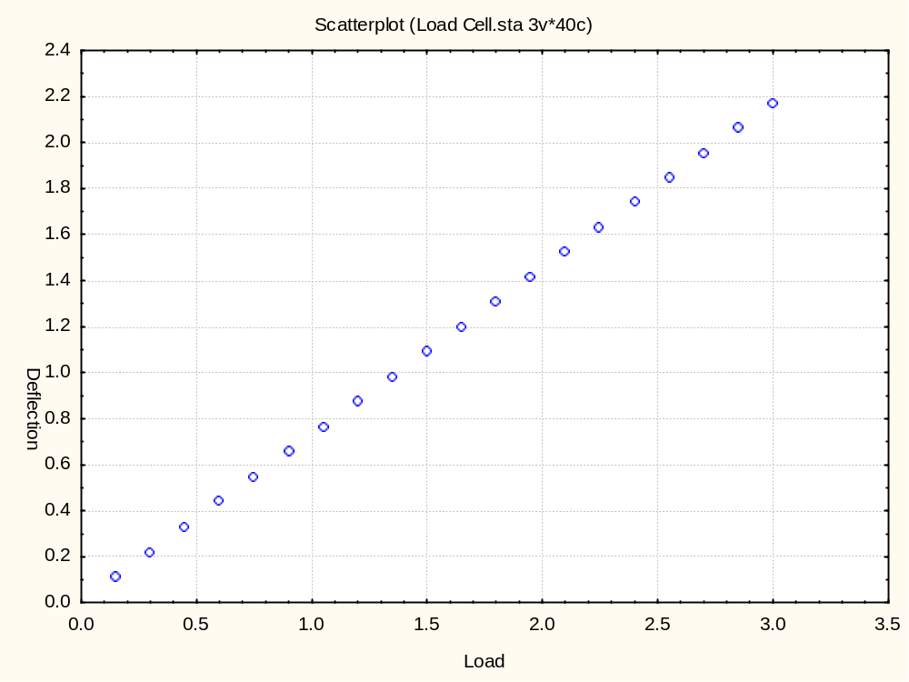
Notes:
Selection of Initial Model
Start Simple: The first step in analyzing the data is to select a candidate model. In the case of a measurement system like this one, a fairly simple function should describe the relationship between the load and the response of the load cell. One of the hallmarks of an effective measurement system is a straightforward link between the instrumental response and the property being quantified.
Plot the Data: Plotting the data indicates that the hypothesized, simple relationship between load and deflection is reasonable. The plot above shows the data. It indicates that a straight-line model is likely to fit the data. It does not indicate any other problems, such as presence of outliers or non-constant standard deviation of the response.

Slide 16
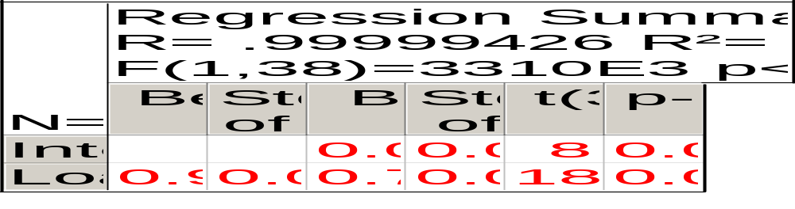
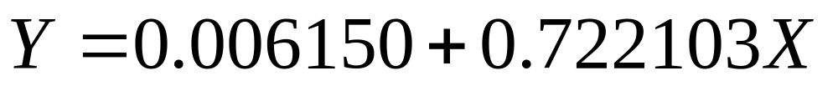
Model Fitting - Initial Model
Notes:
Using software for computing least squares parameter estimates, the straight-line model,
Y = b₀ + b₁X
is easily fit to the data. The computer output from this process is shown above. Before trying to interpret all of the numerical output, however, it is critical to check that the assumptions underlying the parameter estimation are met reasonably well. The next two sections show how the underlying assumptions about the data and model are checked using graphical and numerical methods.

Slide 17
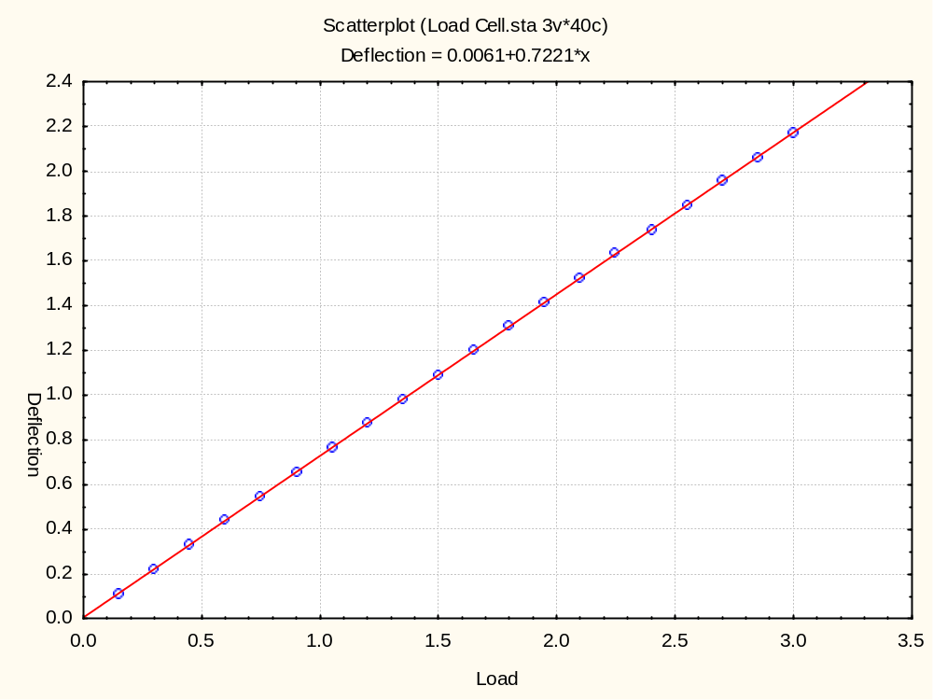
Notes:
Graphical Residual Analysis - Initial Model
After fitting a straight line to the data, many people like to check the quality of the fit with a plot of the data overlaid with the estimated regression function. The plot above shows this for the load cell data. Based on this plot, there is no clear evidence of any deficiencies in the model. This type of overlaid plot is useful for showing the relationship between the data and the predicted values from the regression function; however, it can obscure important detail about the model. Plots of the residuals, on the other hand, show this detail well, and should be used to check the quality of the fit. Graphical analysis of the residuals is the single most important technique for determining the need for model refinement or for verifying that the underlying assumptions of the analysis are met.
Residual plots of interest for this model include:
residuals versus the predictor variable
residuals versus the regression function values
residual run order plot
residual lag plot
histogram of the residuals
normal probability plot

Slide 18
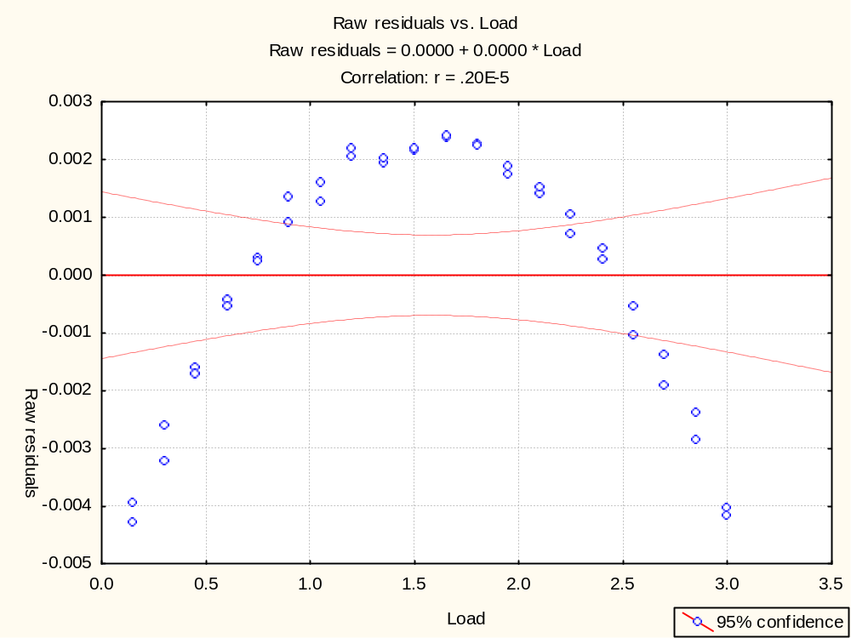
Notes:
A plot of the residuals versus load is shown above.
The structure in the relationship between the residuals and the load clearly indicates that the functional part of the model is misspecified. The ability of the residual plot to clearly show this problem, while the plot of the data did not show it, is due to the difference in scale between the plots. The curvature in the response is much smaller than the linear trend. Therefore the curvature is hidden when the plot is viewed in the scale of the data. When the linear trend is subtracted, however, as it is in the residual plot, the curvature stands out.

Slide 19
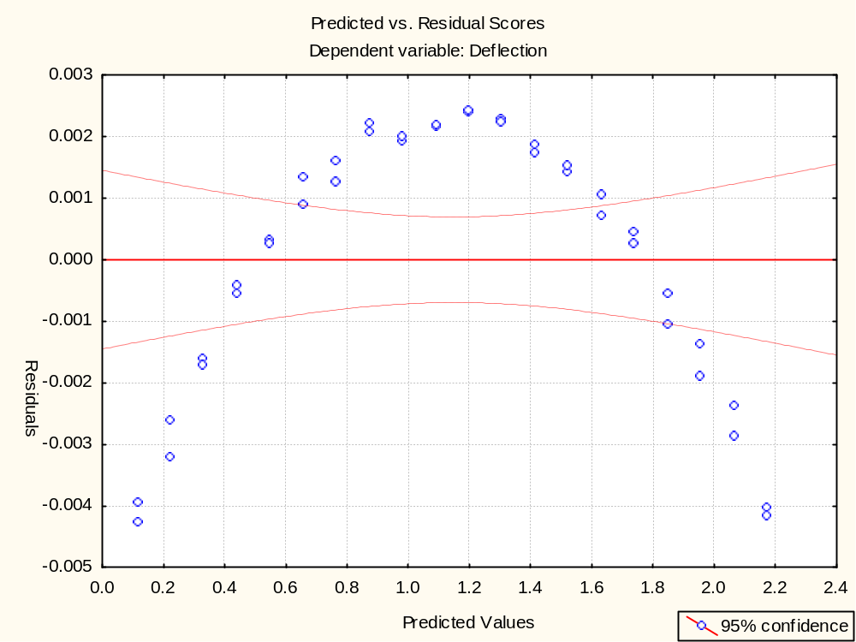
Notes:
The plot of the residuals versus the predicted deflection values shows essentially the same structure as the last plot of the residuals versus load. For more complicated models, however, this plot can reveal problems that are not clear from plots of the residuals versus the predictor variables.

Slide 20
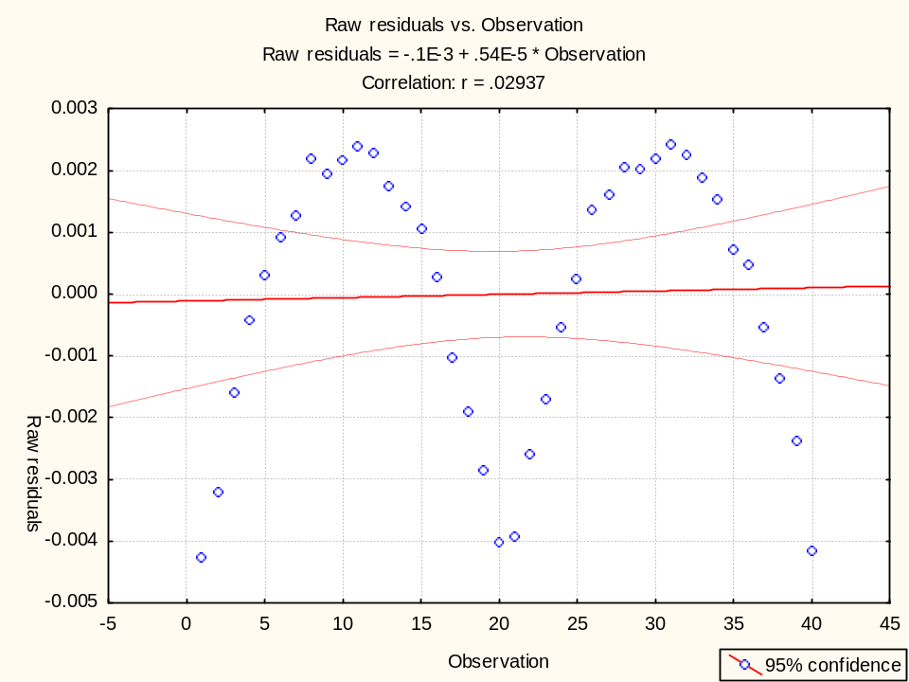
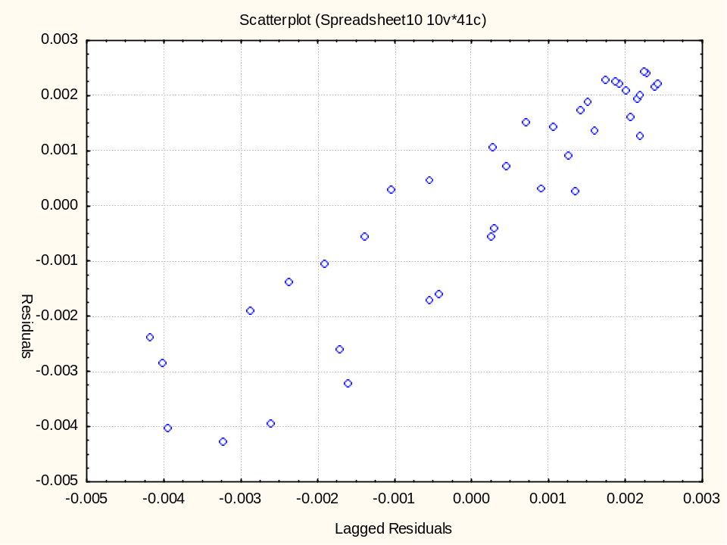
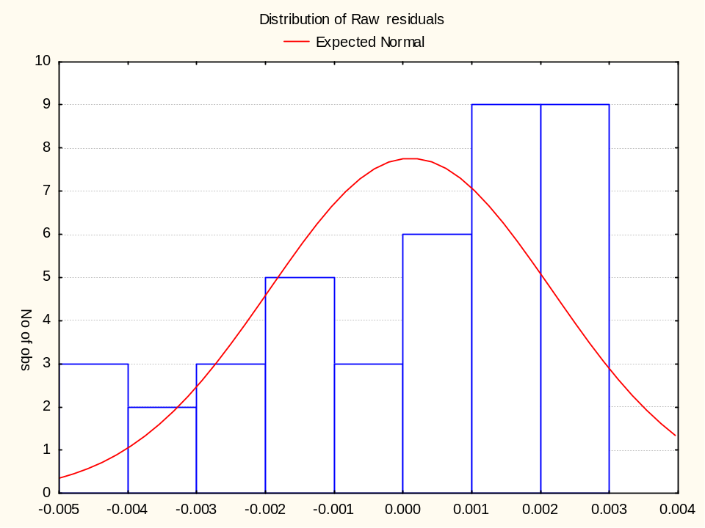
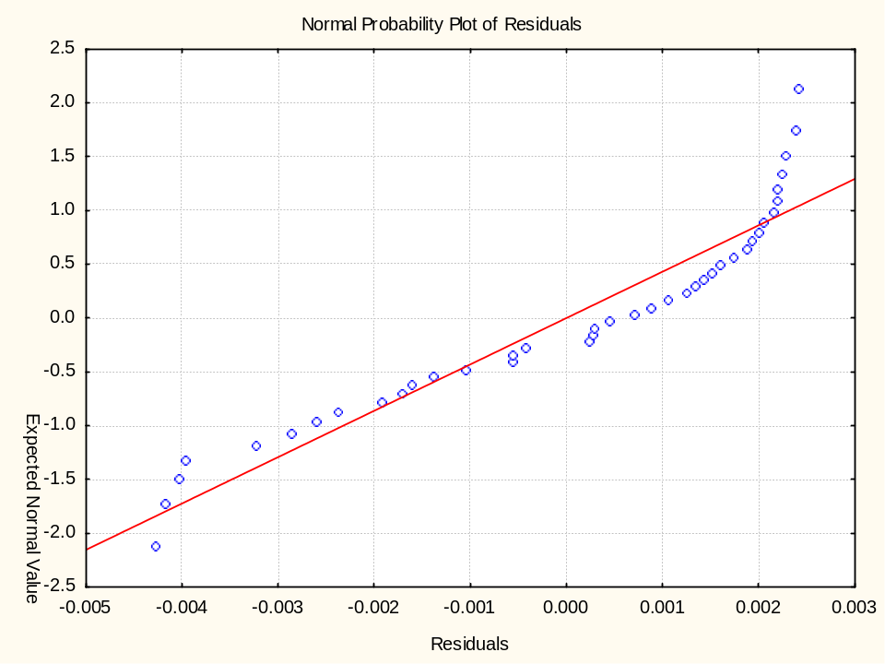
Notes:
Further residual diagnostic plots are shown above. The plots include a run order plot, a lag plot, a histogram, and a normal probability plot. Shown in a two-by-two array like this, these plots comprise a 4-plot of the data that is very useful for checking the assumptions underlying the model.
The structure evident in these residual plots also indicates potential problems with different aspects of the model. Under ideal circumstances, the plots in the top row would not show any systematic structure in the residuals. The histogram would have a symmetric, bell shape, and the normal probability plot would be a straight line. Taken at face value, the structure seen here indicates a time trend in the data, autocorrelation of the measurements, and a non-normal distribution of the residuals.
It is likely, however, that these plots will look fine once the function describing the systematic relationship between load and deflection has been corrected. Problems with one aspect of a regression model often show up in more than one type of residual plot. Thus there is currently no clear evidence from the 4-plot that the distribution of the residuals from an appropriate model would be non-normal, or that there would be autocorrelation in the process, etc. If the 4-plot still indicates these problems after the functional part of the model has been fixed, however, the possibility that the problems are real would need to be addressed.

Slide 21
Notes:
Model Refinement
After ruling out the straight line model for these data, the next task is to decide what function would better describe the systematic variation in the data. Reviewing the plots of the residuals versus all potential predictor variables can offer insight into selection of a new model, just as a plot of the data can aid in selection of an initial model. Iterating through a series of models selected in this way will often lead to a function that describes the data well.
The horseshoe-shaped structure in the plot of the residuals versus load suggests that a quadratic polynomial might fit the data well. Since that is also the simplest polynomial model, after a straight line, it is the next function to consider.

Slide 22
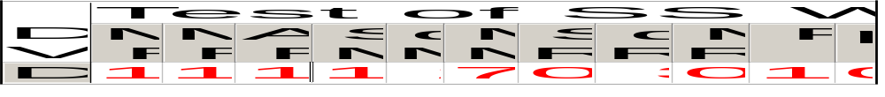
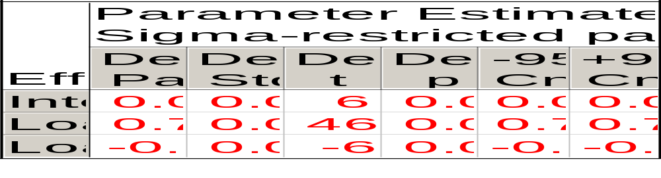
Model Fitting - Model #2
Notes:
Based on the residual plots, the function used to describe the data should be the quadratic polynomial:
Y = b₀ + b₁X + b₁₁X²
The computer output from this process is shown above. As for the straight-line model, however, it is important to check that the assumptions underlying the parameter estimation are met before trying to interpret the numerical output. The steps used to complete the graphical residual analysis are essentially identical to those used for the previous model.

Slide 23
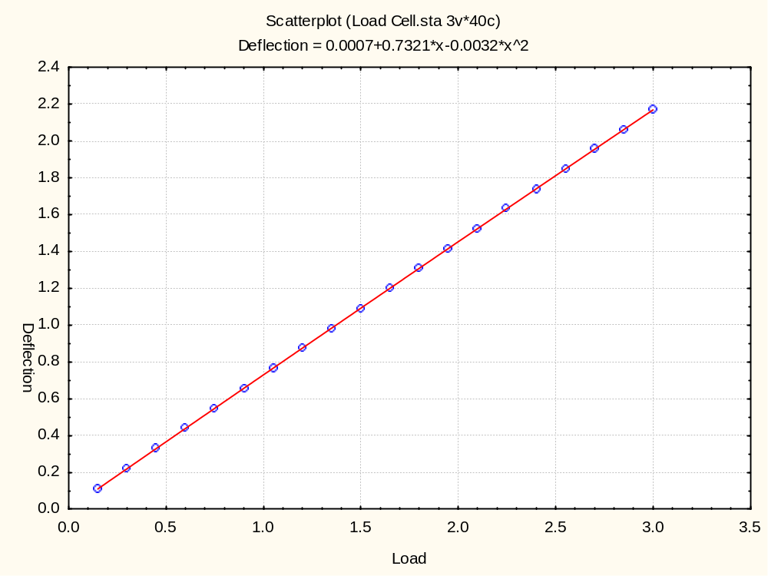
Notes:
Graphical Residual Analysis - Model #2
The data with a quadratic estimated regression function and the residual plots are shown above.
This plot is almost identical to the analogous plot for the straight-line model, again illustrating the lack of detail in the plot due to the scale. In this case, however, the residual plots will show that the model does fit well.

Slide 24
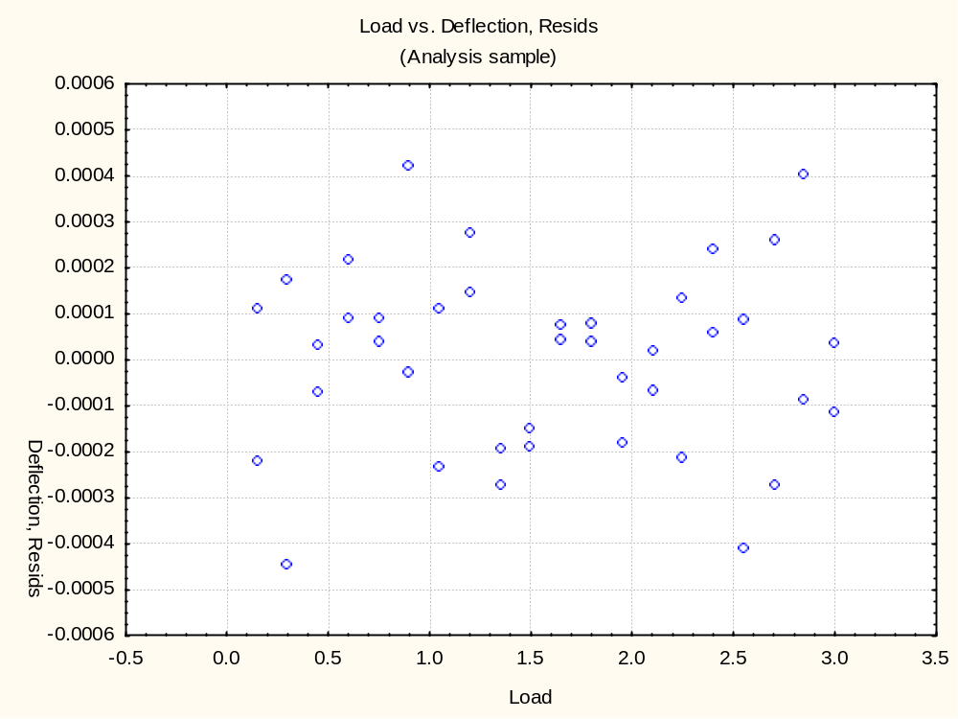
Notes:
The residuals randomly scattered around zero, indicate that the quadratic is a good function to describe these data. There is also no indication of non-constant variability over the range of loads.

Slide 25
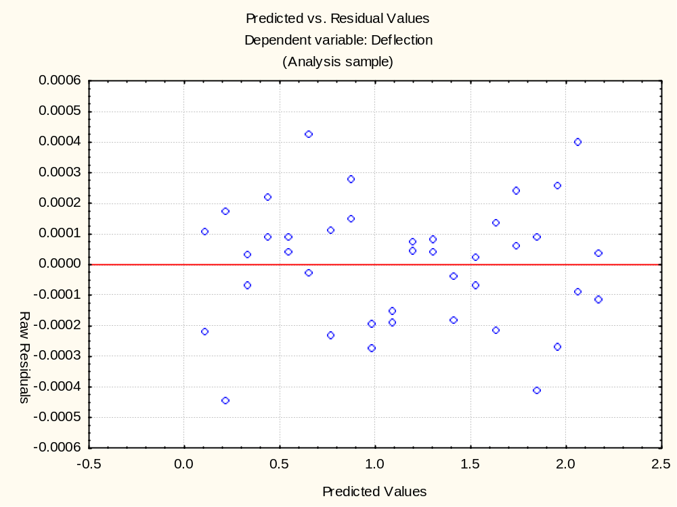
Notes:
This plot also looks good. There is no evidence of changes in variability across the range of deflection.

Slide 26
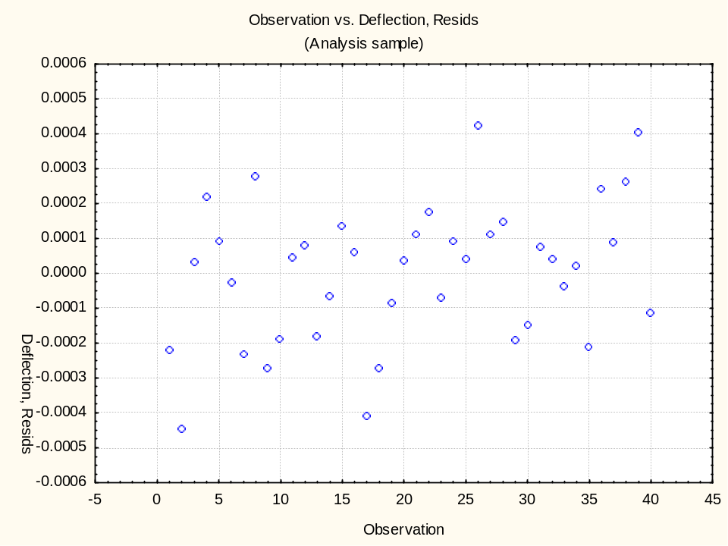
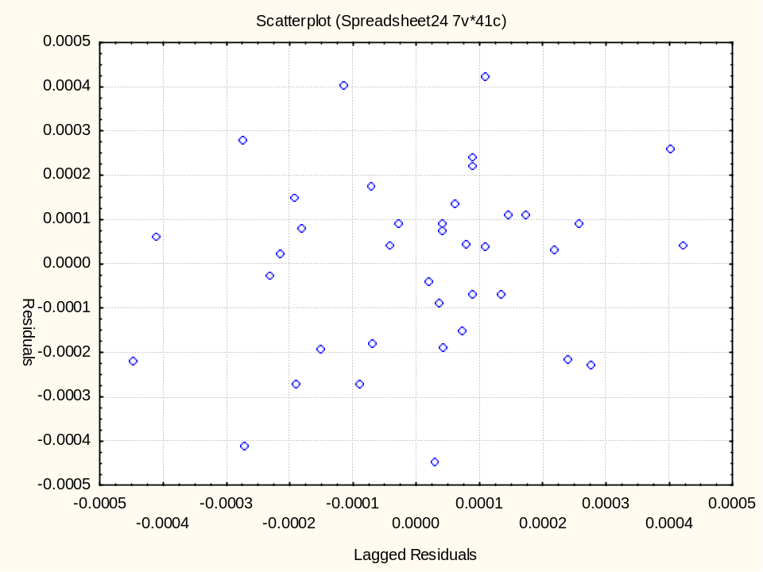
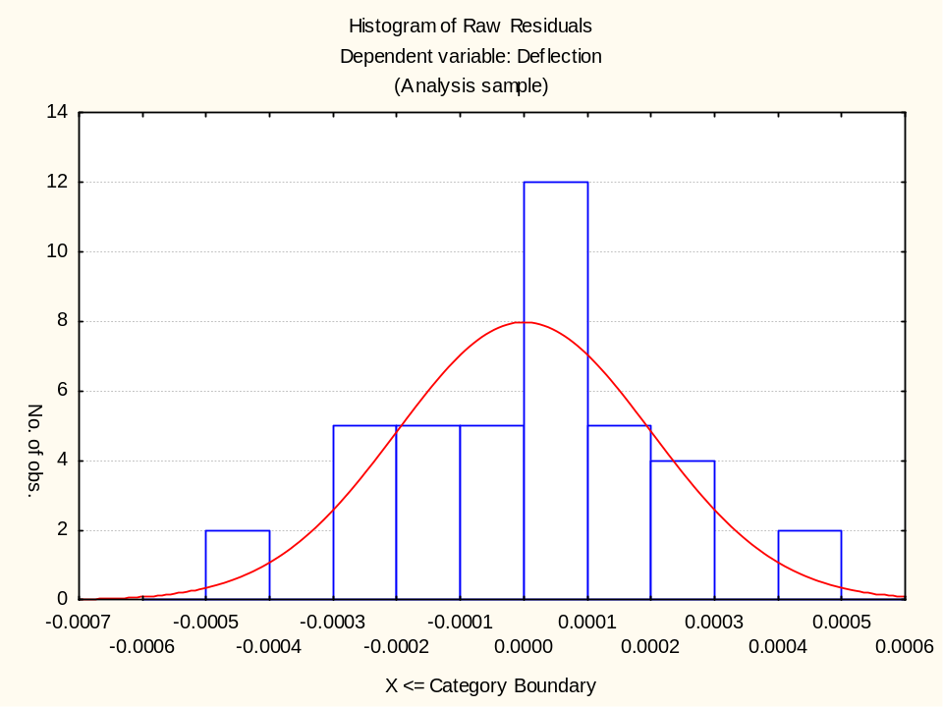
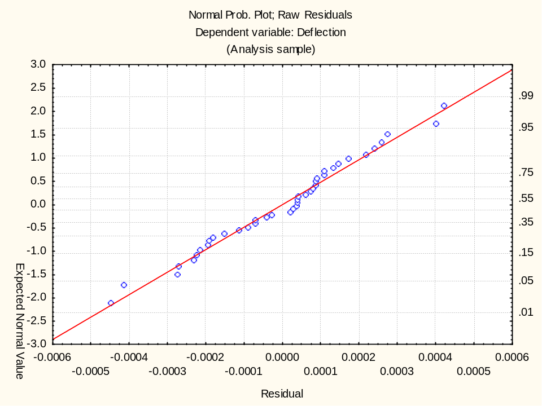
Notes:
All of these residual plots have become satisfactory by simply by changing the functional form of the model. There is no evidence in the run order plot of any time dependence in the measurement process, and the lag plot suggests that the errors are independent. The histogram and normal probability plot suggest that the random errors affecting the measurement process are normally distributed.

Slide 27
Regression Function
Notes:
From the numerical output, we can also find the regression function that will be used for the calibration. The function, with its estimated parameters, is
All of the parameters are significantly different from zero, as indicated by the associated t statistics. The 97.5% cut-off for the t distribution with 37 degrees of freedom is 2.026. Since all of the t values are well above this cut-off, we can safely conclude that none of the estimated parameters is equal to zero.

Slide 28
Notes:
Use of the Model for Prediction
Now that a good model has been found for this dataset, it can be used to estimate deflection values for new measurements of load. For example, suppose a new load value of 1,705,106 (scaled to 1.70516) is observed. The regression function can be used to determine an estimated deflection value without having to observe it directly. The plot above illustrates the calibration process graphically.
From the plot, it is clear that a load of 1.7x10+6 should produce a deflection of a little more than 1.2. This is a rough estimate of the possible deflection, so we should compute the deflection estimate numerically:
Y = 0.000674+0.732059X-0.003160X²
= 0.000674+0.732059(1.70516)-0.003160(1.70516)²
= 0.000674+1.248238-0.009190 = 1.239722
In this example, since the R² value is essentially 1, there is no error in the model to worry about, so a prediction interval is not necessary.

Slide 29
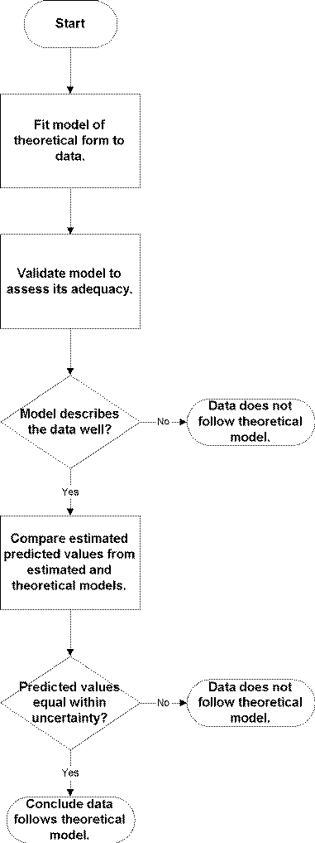
How can I tell if a set of data is consistent with a particular theoretical model?
Notes:
Flowchart from www.itl.nist.gov/div898/handbook/toolaids/eq/eq5.htm
General Modeling Steps
Identify the output responses that need to be measured, i.e. the critical or quality parameters
Note how accurate the output needs to be *
Identify the input signal, the control parameters and their limits, and noises *
Understand analytical modeling capabilities *
Understand physical modeling capabilities *
Select the most appropriate modeling method *
Perform the analysis or experiments
Verify the results
* DFSS Measure
Ullman, David G., The Mechanical Design Process (2003), p. 262-266

Slide 30
Measure
SS 301: Design For Six Sigma
Deere & Company
Notes:
Measure Outline
Overview
Select Analysis System
Predict Historical Data
Evaluate Prediction Error
Validate Measurement System [3]

Slide 31

Measure
Notes:
Plan and conduct the necessary research to understand the customer needs and associated requirements.
If necessary, translate these needs and requirements into measurable characteristics (CTQs).
“The Evolution of Six Sigma” by Hahn, Doganaksoy, and Hoerl

Slide 32

Consider the alternatives... The Homer
Notes:
If we fail to adequately measure customer wants and needs by market segment, we might end up with “The Homer” car
http://www.megahobby.com/Modeling_Zone/Snap_City/snap_city.html

Slide 33

Measure Example
Notes:
Molded parts need to be capable of attaining tight specifications on color matching between adjacent vehicle parts (e.g., panels and attachments)
Customer requirements on degree of agreement amount color of vehicle parts are thoroughly explored and quantified
This might involve a designed experiment whereby a panel of customers is asked to judge the difference among vehicle parts
The resulting observed color differences are then expressed quantitatively based on well-established spectraphotometric measurements such as as “L” (light-dark), “a” (red-green) and “b” (yellow-blue)
Adapted from “The Evolution of Six Sigma” by Hahn, Doganaksoy, and Hoerl

Slide 34
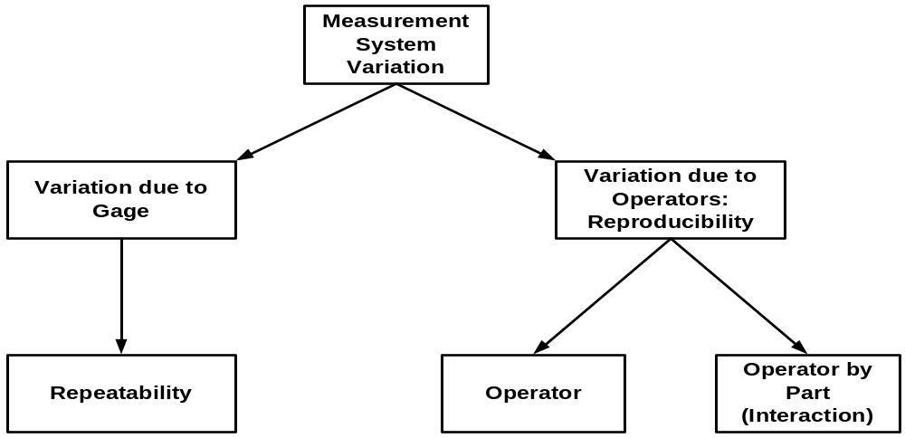
MSA Fundamentals
σ²_{Total} = σ²_{Product} + σ²_{Measurement}
Notes:
Measurement Systems Analysis (MSA)
When studying variation, good measurements are required.
Many times an evaluation of the measurement system should be performed using a gage R&R or similar study.
http://www.variation.com/techlib/val-1.html
Gage Repeatability & Reproducibility: Determine if the measurement system is adequate to measure part-to-part variability in the process
PPAP Section 4.11.4: “Evidence is required that appropriate statistical studies have been conducted to analyze the variation…”

Slide 35
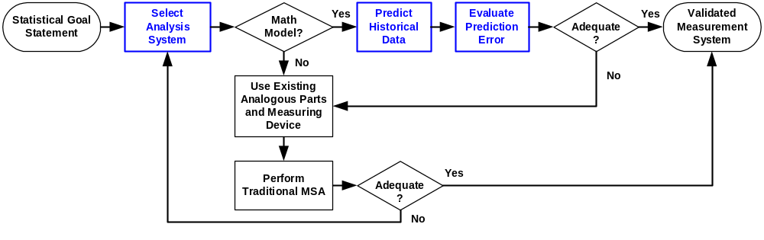
DFSS Measure
Validate Measurement System [3]
Correlation Study
Notes:
Six Sigma Leading Questions
What do I need to know to make a good statistical decision?
Where can I find the data?
How do I validate the measurement system?

Slide 36
Measure:
Select Analysis System
Notes:
The actual development of the requirements and their respective analysis strategies and optimization of the CTQ flow-down tree can be somewhat discipline specific.
For instance, the CTQ may be linked through a finite element model in mechanical engineering, circuit simulation in electrical engineering or process simulation in chemical engineering or designing of business processes.
Or the CTQ may be a product specific system simulation tool.
In any case, how those models are created and specifically analyzed and optimized is an important part of DFSS.
“DFSS and Big Payoffs” by by Maurice L. Berryman

Slide 37
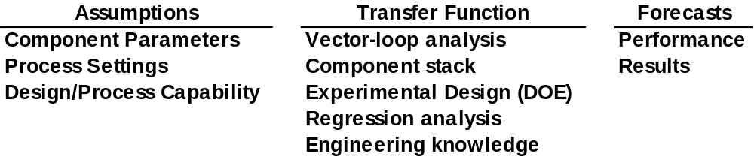
Creating a Model for a Six Sigma Application
Input
Y = f(x)
Output
Notes:
What is a Model? Replication or representation of a real system
Manufacturing-production models
Part Definition
Planning-queuing models
Financial-forecasting models
Common computer modeling environments:
Spreadsheets
Computer Sided Design/Solid modeling
Finite Element Analysis Packages
Graphical – flow charting tools

Slide 38
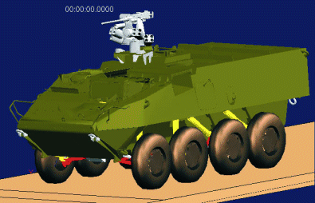
Analysis and Optimization Considerations
Figure 1: Mechanical Simulations International developed the dynamic simulation of the Stryker, which produces the force and acceleration time history of the vehicle traversing terrain. This information will be used in the suspension component fatigue analysis
Notes:
Some of the considerations for analysis and optimization are:
Multivariable optimization.
Design of experiments to create models [3].
The advantages and disadvantages of different statistical analysis techniques [4].
Probabilistic design strategies.
Robust design considerations to minimize the propagation of error [5].
Simulation techniques.
Failure mode and effects analysis to help identify CTQs.
Other complex analysis strategies.
“DFSS and Big Payoffs” by by Maurice L. Berryman

Slide 39
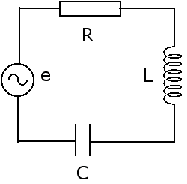
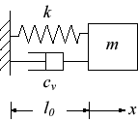

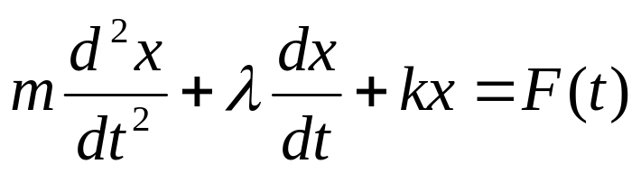
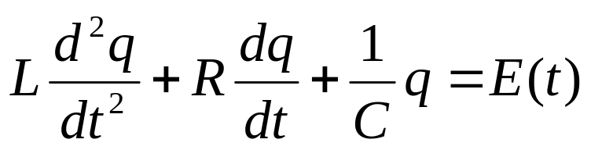
Mechanical System
Electrical Circuit
Notes:
Note the analogy between mechanical vibrations and electrical circuits in terms of mathematical modeling

Slide 40
Mechanical System
Electrical Circuit
Mass = m
Frictional resistance = λ
Spring constant = k
External force = F(t)
Displacement = x
Velocity = v = dx/dt
Inductance = L
Electrical resistance = R
1/Capacitance = 1/C
Voltage = E(t)
Electrical charge = q
Current = i = dq/dt
Notes:
The solutions to these 2nd order differential equations are the same
Conclusions
Many physical problems when formulated mathematically are identical!
In the case of mechanical vibrations, we could build the corresponding electrical circuit and then measure the “current”
Can develop design simulations from free-body diagrams or circuits diagrams and their corresponding modeling equations

Slide 41
Two Approaches for Obtaining Transfer Functions
Experiment
or
Simulation
A
Y,
B
A
E
C
D
B
66 “
12”
E
C
Notes:
1. Collect data by carrying out an experiment and attempt to obtain a formula using statistical analysis, i.e. empirical
2. Try a theoretical method to deduce a formula, i.e. analytical
Adapted from Guide to Mathematical Modeling, Dilwyn Edwards & Mike Hamson, p. 6

Slide 42

Analytical Modeling Issues
Figure 3: The solid model of the trailer was used to develop the dynamic simulation model and the finite element model used in the physics-of-failure analysis
Notes:
What level of accuracy is needed?
Are analytical models available that can give the needed accuracy? If not, then physical models are required.
Are deterministic solutions sufficient?
If no analytical techniques are available, can they be developed?
Can the analysis be performed within the resource limitations of time, money, knowledge, and equipment?
Ullman, David G., The Mechanical Design Process (2003), p. 264-265

Slide 43

Special Purpose Analysis Tools
Figure 2: University of Maryland CALCE software was used to calculate the displacement of circuit cards during vibration. This information was used to estimate component life.
Notes:
Stress and Strain Analysis Tools, e.g. NASTRAN
Kinematic and Dynamic Analysis Tools, e.g. Adams
Fluid and Thermal Analysis Tools, e.g. Kuli
Electrical/Electronic Tools, e.g. Spice
System Analysis Tools, e.g. Mathlab, Saber
Adapted from Ullman, David G., The Mechanical Design Process (1992), p. 80-84

Slide 44




Measurement Translation
Notes:
Sometimes we cannot measure the CTQ directly
But we can measure something that we can infer the CTQ from a translation of the CTQ

Slide 45

Notes:
Example of poor measurement translation
Can we predict Case Depth from Eddy Current measurements? No!
Why? r² = 0.14

Slide 46

Notes:
Example of good measurement translation
Can we predict CMM results from Ultrasound measurements? Yes!
Why? r² = 0.85

Slide 47
Measure:
Predict Historical Data
Notes:
Need data!
Need data to evaluate how well the analytical model performs
Most likely there are no parts available for the new design; otherwise, why would you be doing this project?
Therefore use data from an old design, i.e. historical data

Slide 48


Example: Electronics Model Validation
Notes:
Can we use the model to predict performance of an electrical circuit board?

Slide 49

Data: Model versus Reality
Notes:
Recall the simple linear regression example: You decide to model 12 designs and estimate the performance and then build 12 prototypes and measure the performance. Each “experiment” compares the model to reality.

Slide 50
Notes:
Here’s the scatter plot just to refresh your memories.
It’s always a good idea to look at the data.
As Yogi Berra said, “You can observe a lot by watching.”
[http://www.yogi-berra.com/yogiisms.html]

Slide 51


Analogous Regression ANOVA
Notes:
Using Model versus Reality experiment data, would report that the %Error is 10.61%
MSE = Mean Square Error, i.e. Mean Square in the Residual row
Note: “Std. Error of estimate” equals square root of MSE and estimates the standard deviation σ

Slide 52




%Error Relationship to r²
Notes:
SSR = Sum of Squares Regression
SSE = Sum of Squares Error, i.e. Sum of Squares Residual
SST = Sum of Squares Total
SSR + SSE = SST

Slide 53

θ
μ_{y} = 3.0
μ_{x} = 1.0
Notes:
This view of the data shows a bivariate normal confidence ellipse.
Mathematical statistics shows that r = cos(θ) = cos(18.1) = 0.9505
Want to make angle θ as small as possible to increase r and r².
So, a good measurement system would have a confidence ellipse that looks like a hotdog, a poor one would look like a thick bratwurst, and a really bad one would look a like a hamburger – just to use a food analogy in case you’re getting hungry...

Slide 54

Notes:
This view of the data shows 95% Prediction Intervals about the fitted line.
This implies that if we gathered an addition measurement of the model, 95 times out of a 100 the measurement of “reality” would fall within the interval.
The Prediction Intervals equation is shown on the next slide.

Slide 55



Prediction Interval
Approximate width of PI
Notes:
The portion of the equation circled in red is the approximate width of the Prediction Interval.
The Z factor is dependent on the confidence level, and it increases as the confidence level increases.
The MSE term is dependent on the variability of the data.
So, if you want to predict future values with high confidence, then the MSE term needs to be very small.

Slide 56

Measurement System Criteria
Notes:
It also a good idea to use the Prediction Interval equation to determine expected error in estimates and judge whether that is acceptable.
There are no strict rules. If a model has better results than the alternatives, then use it.
What’s important is if the model helps you make better decisions. For a linear model, the key is to be directionally correct. For a nonlinear model, slight deviations can have large effects.

